Slide 1
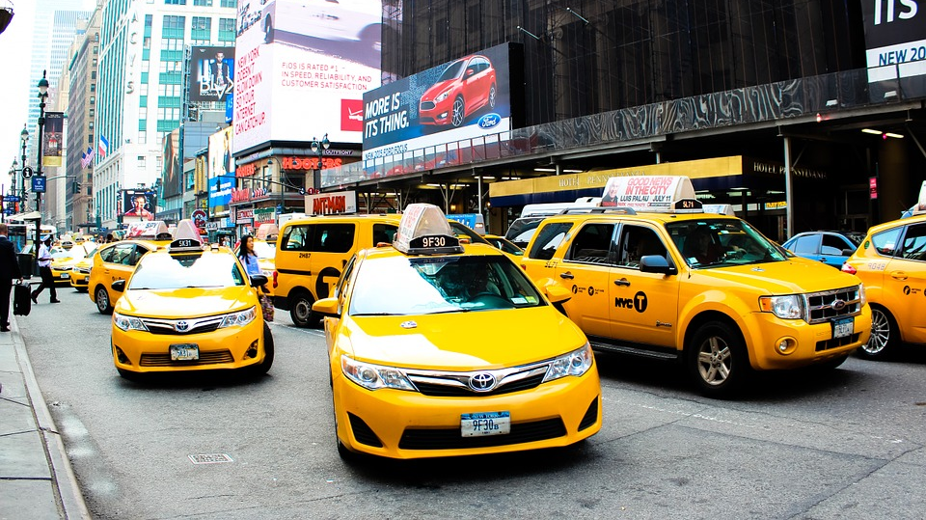
NYC Yellow TAXI
- Sai Kumar Reddy Gheereddy

Slide 2
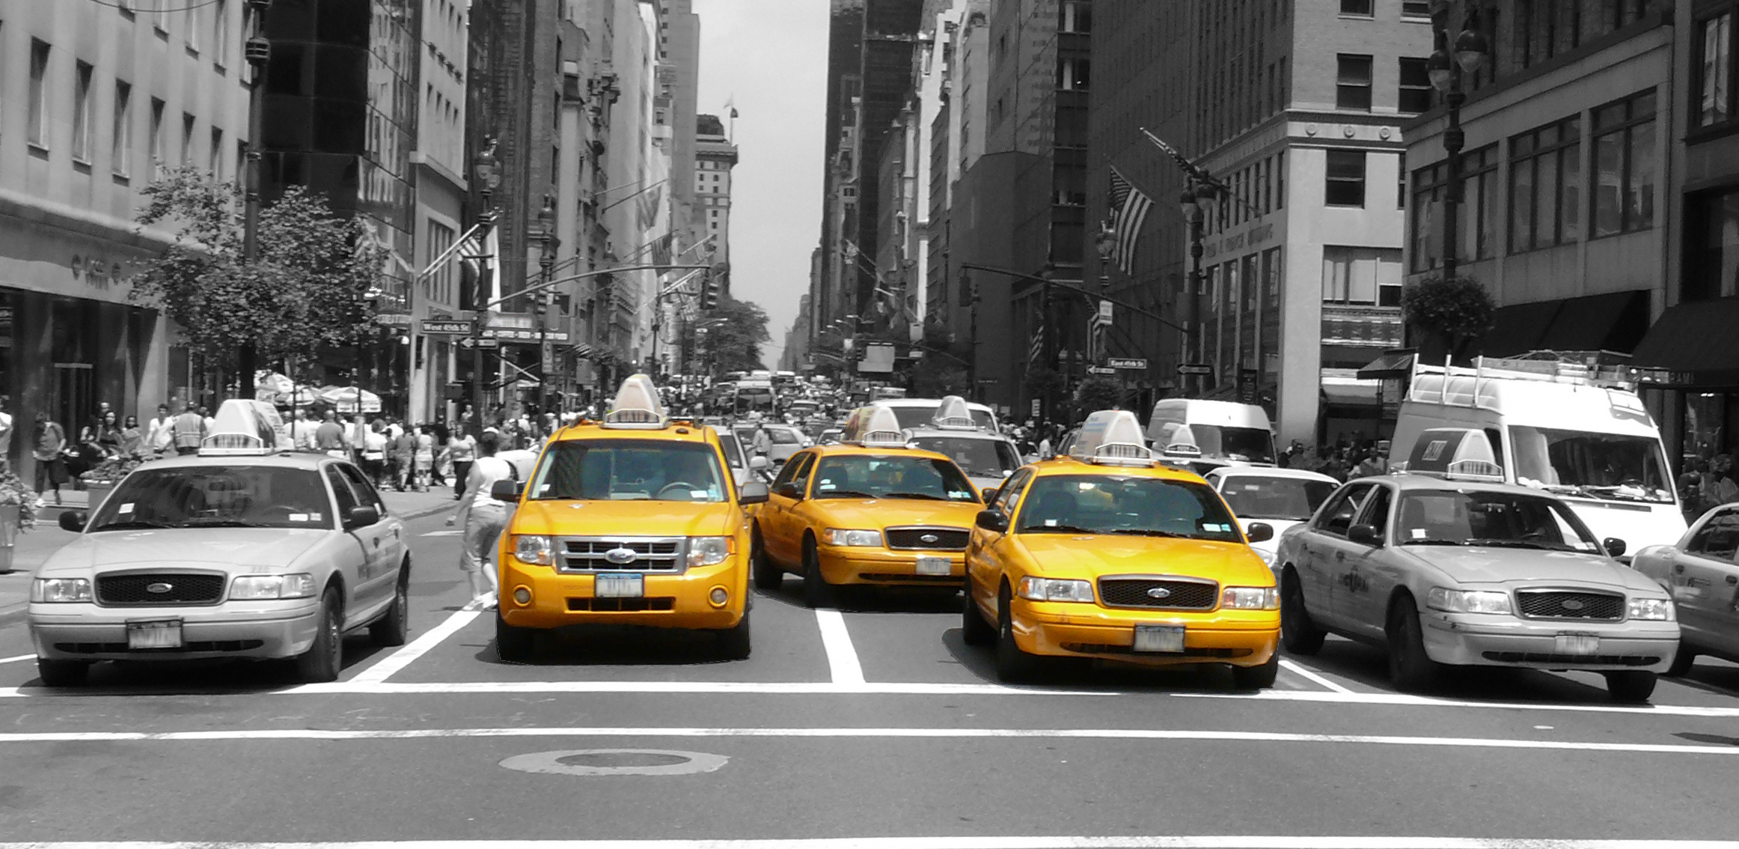
Yellow Taxi is widely recognizable symbol of the NYC

Slide 3
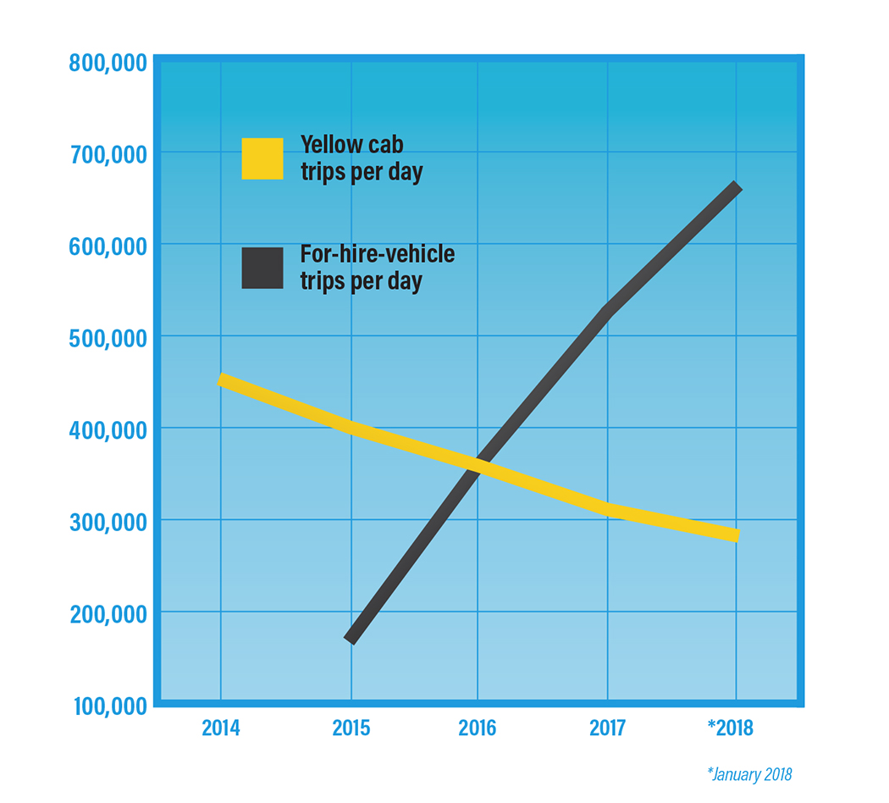
NYC’s yellow cab industry
Competition from Uber/Lyft and other factors has shattered New York’s yellow taxi business, cratering driver earnings
The average money brought in by yellow cab medallions dropped by nearly 30% between 2013 and 2018, from roughly $14,500 per month to $10,200.

Slide 4

Problem: NYC Yellow Cab Drivers' Earnings
Yellow cab drivers in New York City say they don't need a study to tell them what they already know.
The drop in fares and income over the last six years has been devastating.

Slide 5
Dataset- Jan 2019 to Dec 2019
The yellow taxi trip records include fields capturing pick-up and drop-off dates/times, pick-up and drop-off locations, trip distances, itemized fares, rate types, payment types, and driver-reported passenger counts.
The data used in the attached datasets were collected and provided to the NYC Taxi and Limousine Commission (TLC) by technology providers authorized under the Taxicab & Livery Passenger Enhancement Programs (TPEP/LPEP).
We used Azure blob storage to store our data files.

Slide 6

We decided to propose few strategies so that NYC yellow cab drivers can make more profits
This Photo by Unknown Author is licensed under CC BY-SA-NC

Slide 7
Approach
Data Cleaning
Data analysis and Visualization
Conclusion
Recommend strategies

Slide 8
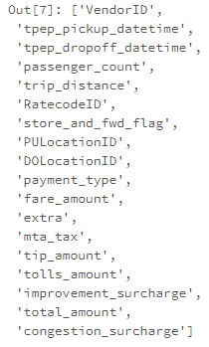
Attributes
Yellow taxi trip data columns
We are using yellow taxi trip data along with taxi zone lookup data
Taxi zone look up columns

Slide 9
Data Cleaning
Total amount is less than 0
Trip distance is 0 miles
Passenger count equal to 0
Trips from the past (e.g. 2001), and trips from the future (e.g. 2090).
There were few trips with unknown vendors
Filtered out such data. After filtering out such data we have a total of ~83 M trips

Slide 10
Distributions
The Passenger counts in the data varies from 0 to 9
The Trip distance has a distribution ranging from 0 to 34 miles
Fare amount lies between 0 to 90 dollars
​People prefer paying the fare through credit card

Slide 11
Derived Attributes
We derived hour, day of week, month from the date
We also derived trip duration & trip speed using trip distance.

Slide 12
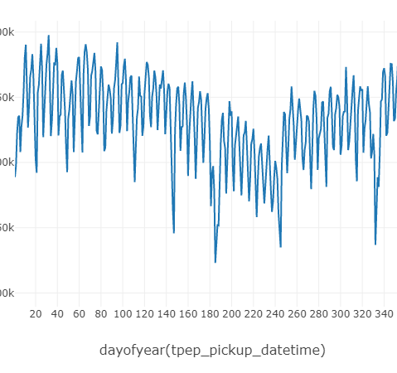
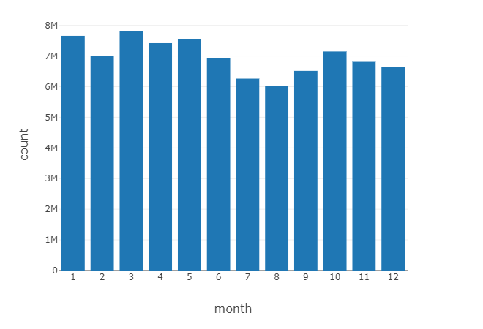
Trip Pattern for 2019
The month of March has the highest number of trips whereas August is the month with the lowest trips in 2019

Slide 13
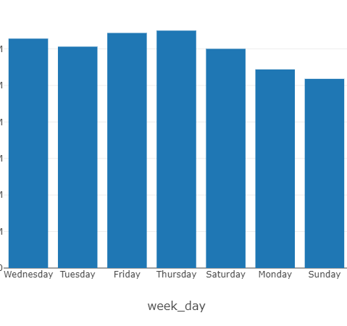
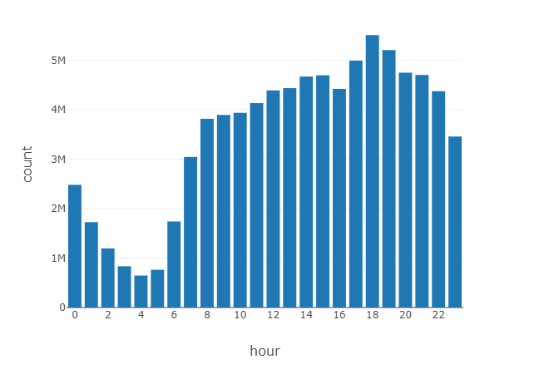
Trip Pattern (Contd)
By analyzing trips on a weekday basis we can see that Thursdays have the highest number of trips whereas Sunday has the lowest.
Hourly analysis of trips shows that the highest number of trips occur between 5 to 7 pm

Slide 14
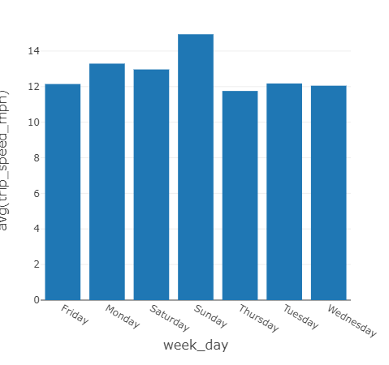
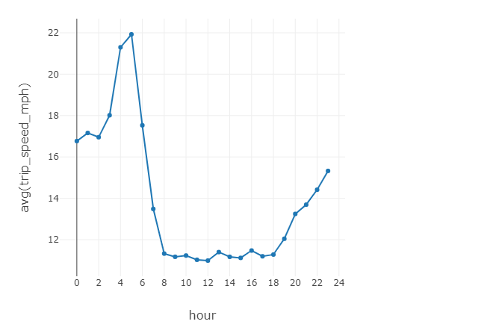
Traffic Congestion
Thursday is the day with the maximum number of trips whereas Sunday had the least number of trips. Based on this information, we can say that Thursday would be the day with the worst traffic.

Slide 15
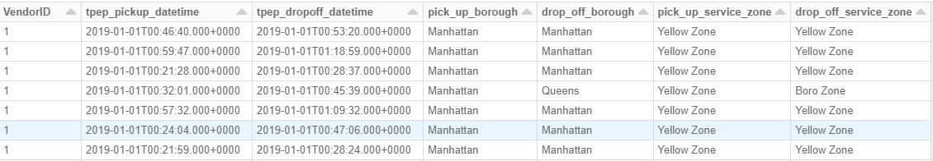
Combining trip data with Taxi Zone lookup

Slide 16
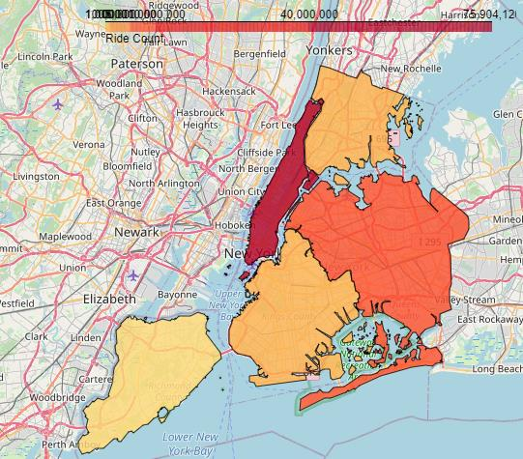
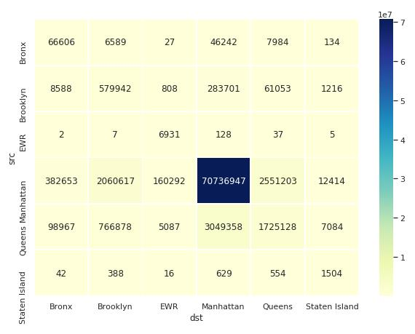
Most Frequent pick-up and drop-off borough
Manhattan is the most frequent pickup and drop off zone
Bronx
Manhattan
Queens
Brooklyn
Staten Island

Slide 17
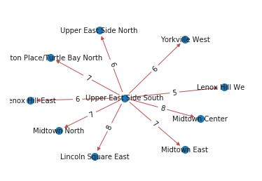
Most frequent Zone
Upper East Side South is the most frequent pickup zone whereas Upper East Side North is the most frequent dropoff zone

Slide 18
Analyzing Rate Codes
Rate code 2, 3
Rate codes 2 and 3 are to JFK and Newark Airports so it is not too surprising that there is extra charge.
Rate code 4
Rate code 4 is trips to Nassau County or Westchester County
Rate code 5
Rate code 5 is for negotiated fares

Slide 19
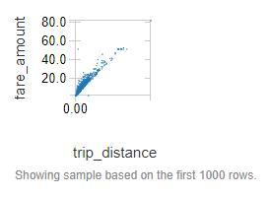
Trip Distance and Fare Amount
The fare amount should ideally increase with trip distance. A scatter plot between trip distance and fare amount shows that there is a linear relationship

Slide 20
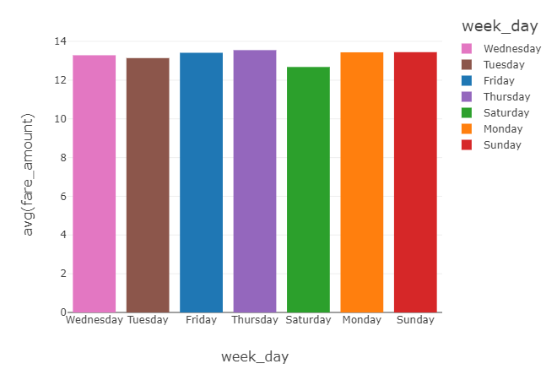
Average Fare per day of the week
We observed that the number of pickups are higher on Thursday and the average fare amount is also high. Whereas, on Saturday the number of trips are lower, the avg fare amount is also low

Slide 21
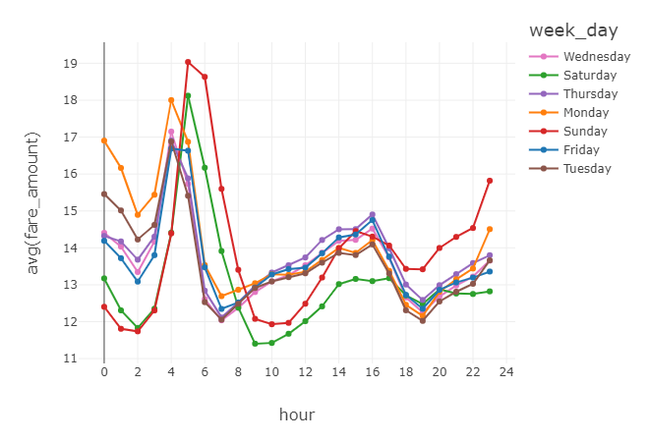
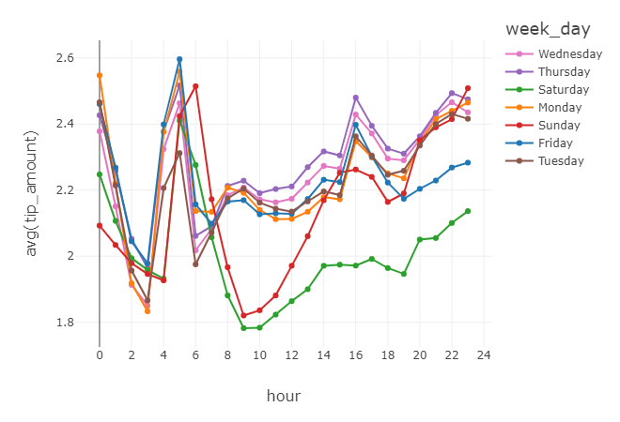
Fare and Tip amount per hour of the day

Slide 22
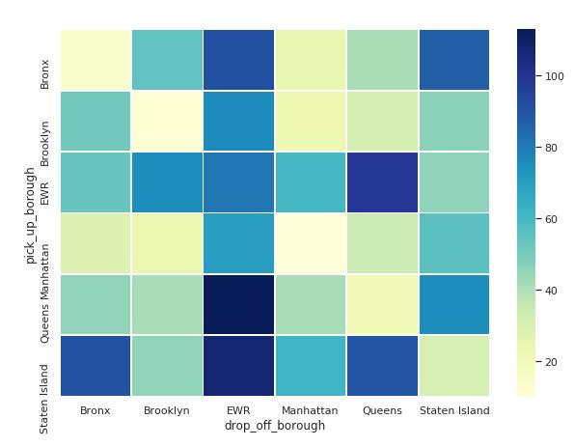
Heat map for fare amount between boroughs

Slide 23
Linear Regression to predict fare amount
We used the following features to predict the fare amount:
pick_up_borough
pick_up_zone
dayofweek
hour
trip_distance
trip_duration_min
Drivers can predict how much fare they can expect to receive on their next trip.
Based on the predicted fare they can determine how much they can expect to receive and can more easily set and reach their goals.
drop_off_borough
drop_off_zone

Slide 24
Benefits
Reduced loss of income
Reduced wait times
Understand various features that yields the highest fare amount

Slide 25
Strategies
High frequency of trips between 5-7 pm during weekdays
Overall less trips on Sundays, but the best time is 5-6 am and 11 pm.
High fair, frequent pickups and tips at late night to early morning hours due to nightlife in NYC on the weekend.
Thursday 1-4 pm and 4 am: Best time for trips
Average fare amount is high between 3-6 am and 2-4 pm
Trips to EWR would help in getting a higher fare.

Slide 26


